Slide 1
CS291I: Almost Real-Time Rubik’s Cube Model Reconstruction
Joseph Ng, Brandon Bu

Slide 2
Introduction
A system for detecting and analyzing the state of a Rubik’s cube
detect cube and detect color to identify each tile’s color and determine its complete state
Aid the user in learning or solving the cube using augmented reality elements

Slide 3
Introduction
A system for detecting and analyzing the state of a Rubik’s cube
detect cube and detect color to identify each tile’s color and determine its complete state
Aid the user in learning or solving the cube using augmented reality elements (no time to implement)

Slide 4
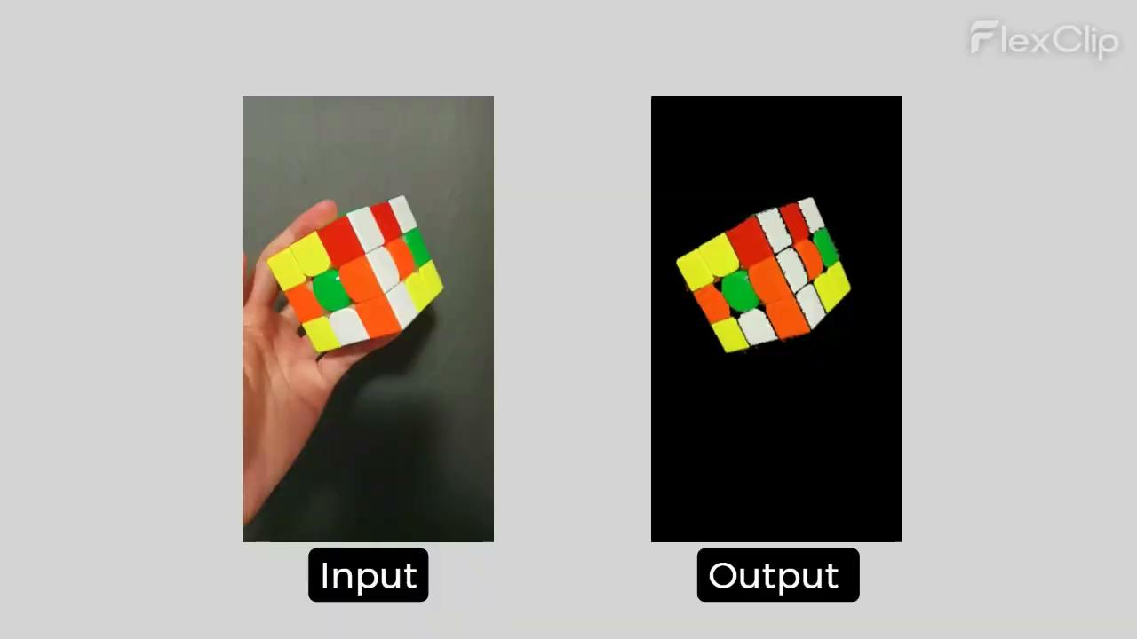
Demo
Notes:
Joseph

Slide 5
Techniques and Tools
Color Masking
YOLO Object Detection
Canny Edge Detection
Contour Detection
Hand Detection/Segmentation
Harris Corner Detection
BundleSDF (6 degrees of freedom/orientation tracking)
Document detection / rectangle fitting

Slide 6
Techniques and Tools
Color Masking
YOLO Object Detection
Canny Edge Detection
Contour Detection
Hand Detection/Segmentation
Harris Corner Detection
BundleSDF (6 degrees of freedom/orientation tracking)
Document detection / rectangle fitting

Slide 7
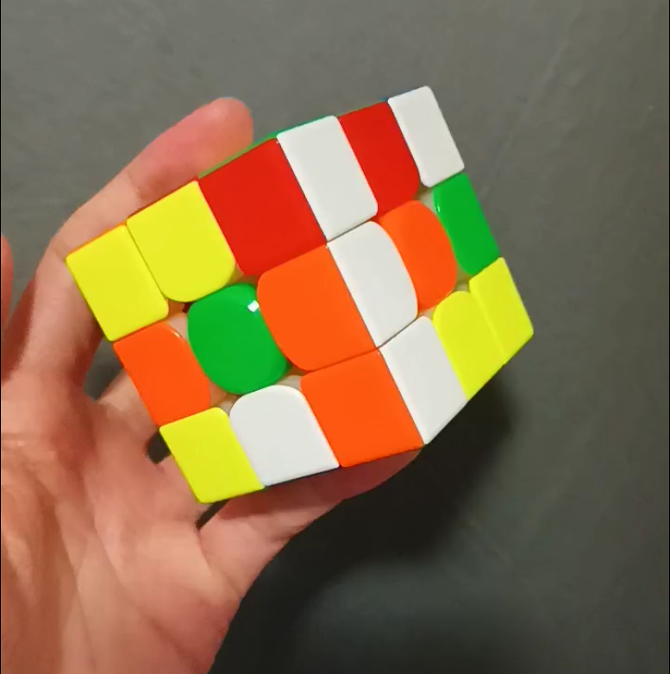
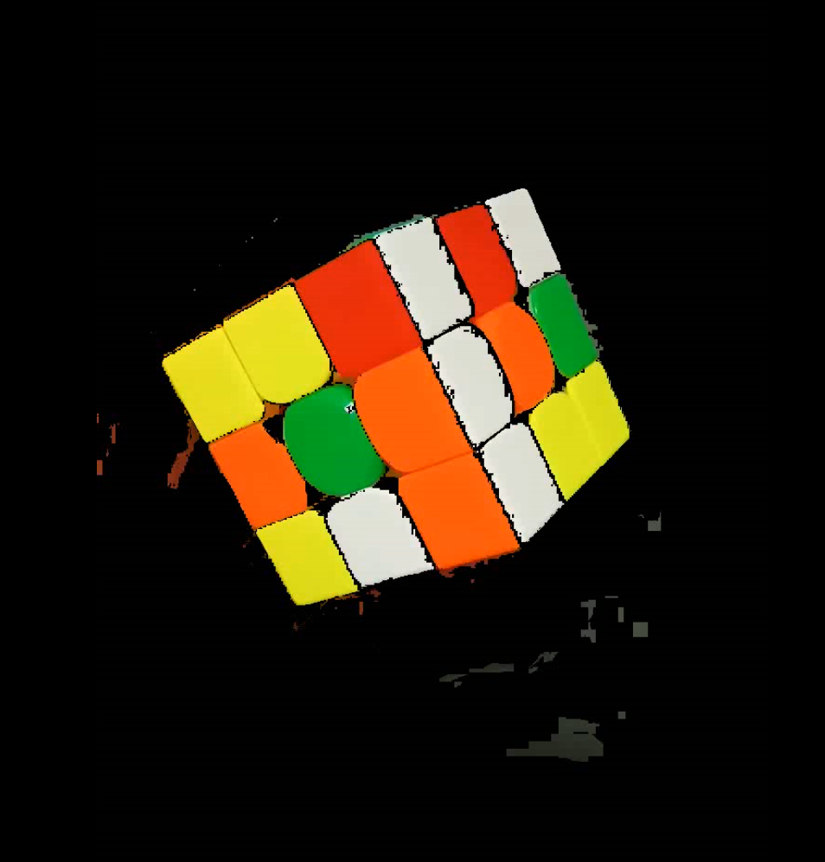
Color Masking/Detection
Color detection is critical for determining the cube’s state
Input for solving Algorithms(Kociemba's)
HSV(Hue, Saturation, Value) Color Space to deal with different lighting
Requires calibration

Slide 8
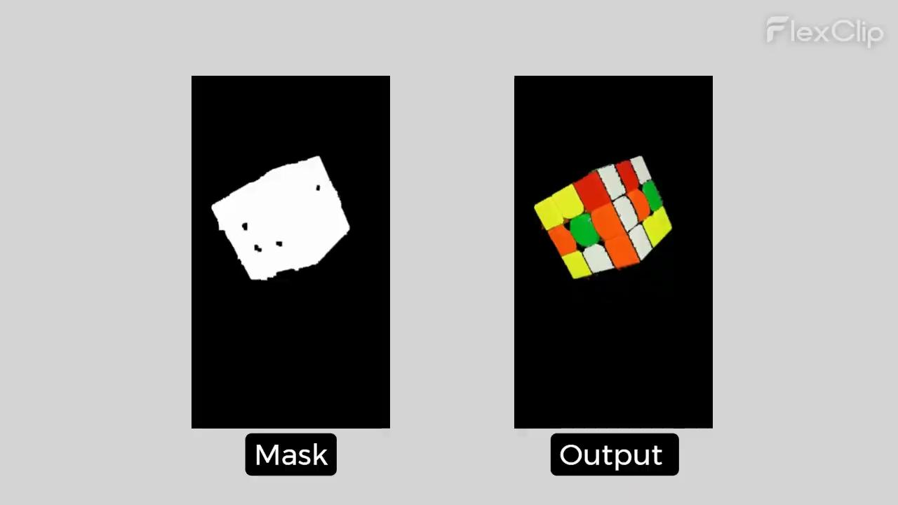

Slide 9
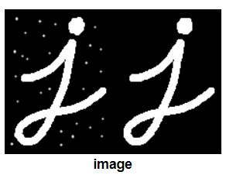
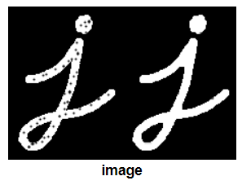
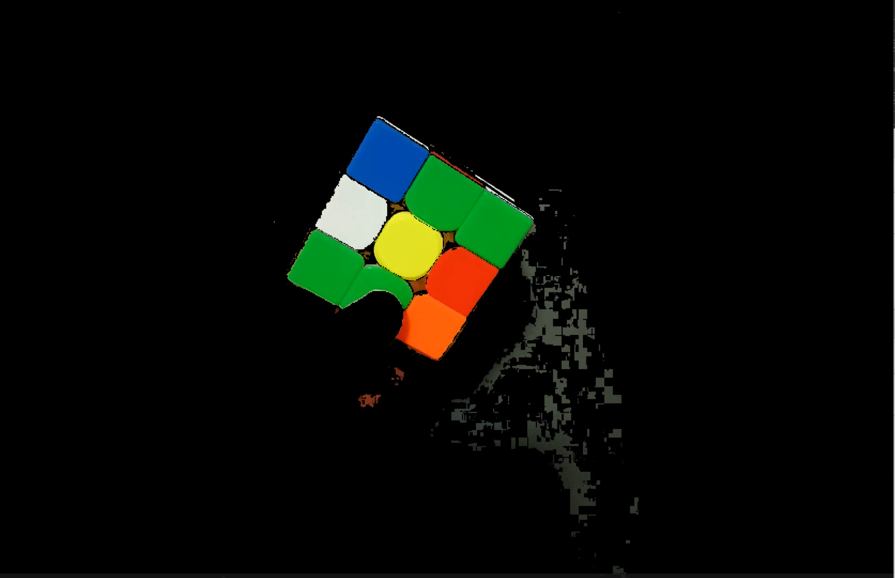
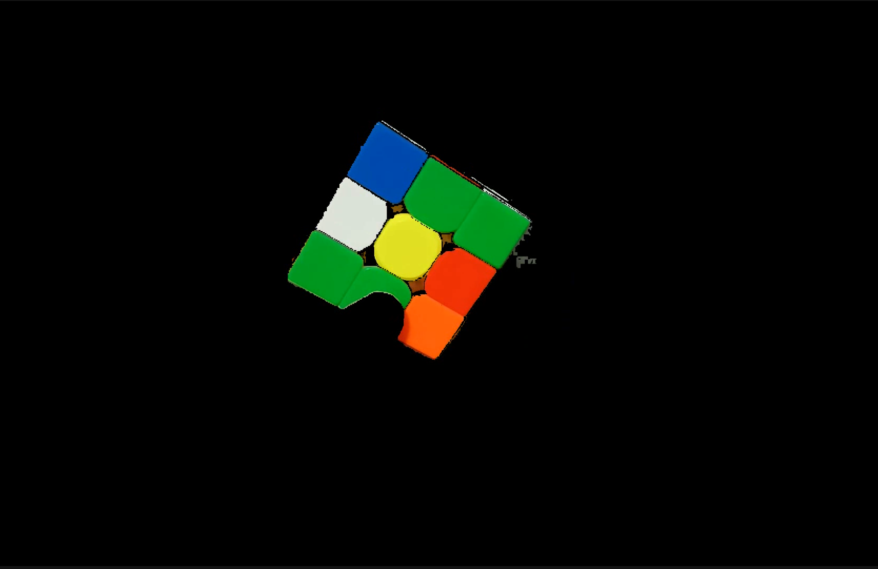



Denoising
Morphological transformations
Implemented a denoising filter techniques including:
Biggest continuous region selection
Morphological transformations
Before
After
Notes:
Joseph

Slide 10
Good Frame
identify good frames that show a high quality cube face and well-centered, enhance the reliability of subsequent analyses
ensure the accuracy and quality of the input data

Slide 11
Future Work and Enhancements
3D Cube Reconstruction
Color tile extraction (in progress)
BundleSDF
Adaptive Color Threshold
Lighting and shadows
User Interaction and Interface
Notes:
Joseph

Slide 12
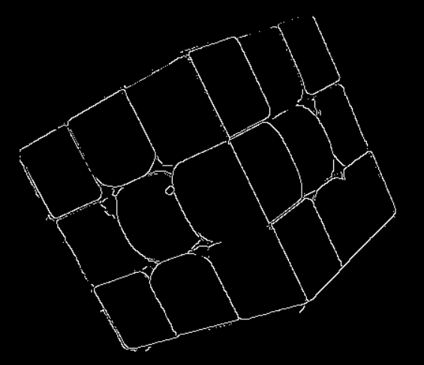
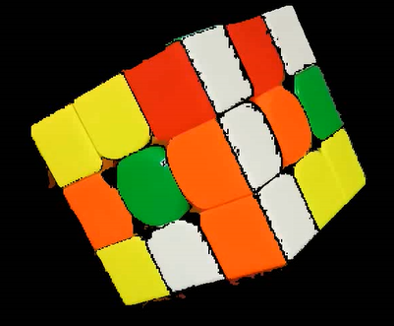
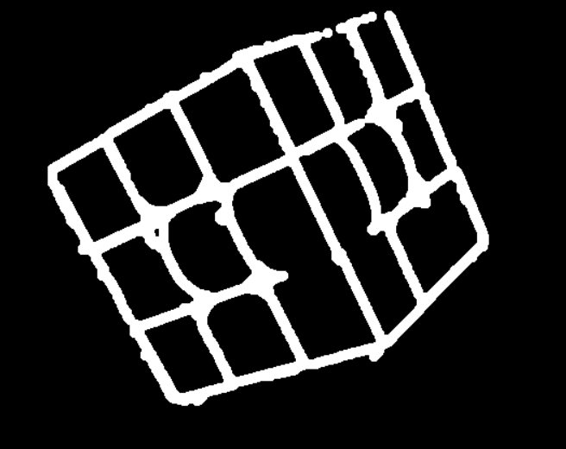
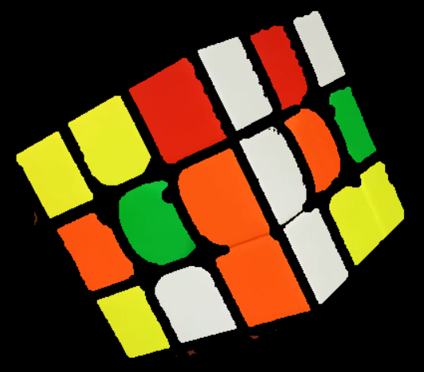
Color Tile Extraction: Edge Detection
Edge Detection
Morphological Transformation (Dilation)
Color Masked Image
Use canny edge detection + morphological transformations to isolate color tiles
Each color region can be extracted
Still work in progress as adjacent tiles does not have a clean boundary
Use size data from clean color tiles to fix this issue
Notes:
Joseph

Slide 13
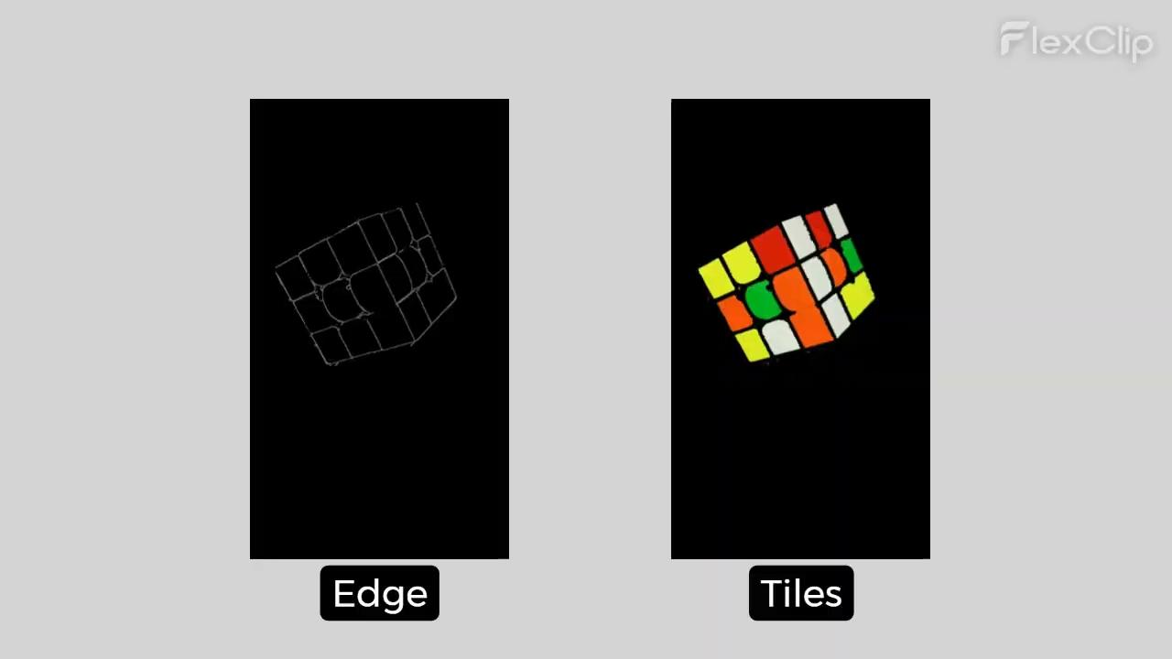
Color Tile Extraction: Edge Detection
Notes:
Joseph

Slide 14
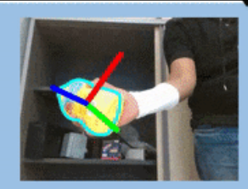
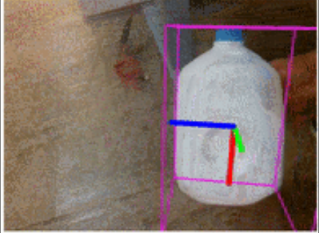
BundleSDF
Use pose tracking for the Rubik’s cube
Cube face planes can be extracted using this information and hence the individual color tiles.
Construct or fit a virtual cube model

Slide 15
Thank you

Slide 16
Q&A

